Slide 1
Ingoude Company
Presentation / Brand Guidline / 2025
BRAND GUIDLINE
2025

Slide 2

ABOUT
INGOUDE
1
FOUNDED
INDUSTRY
2016, 123 Anywhere St., Any City
Sustainable Consumer Products
MISSION
“Empower everyday choices through sustainable design.”

Slide 3



LOGO
2
INGOUDE
( Logo Usage )

Slide 4
BRANDING
COLORS
3
#F0C52B
#FAFAFA
#141414
Yellow Earth
Cloud White
Nano Black

Slide 5

TYPOGRAPHY
4
FONT
( Titles, Headlines )
FONT
( Paragraphs )
Open Sauce
Liberation Sans

Slide 6
IMAGERY STYLE
5
VISUAL TONE
Natural Lighting
Warm Tones
Minimalistic
Clean Settings

Slide 7
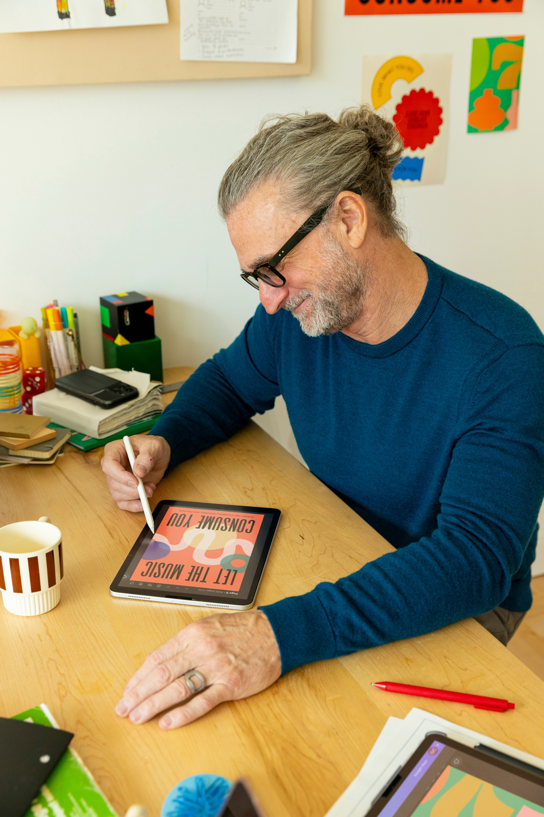
BRAND VOICE
AND TONE
6
CONFIDENT
HONEST
FRIENDLY
CALM
SUPPORTIVE

Slide 8
SOCIAL
MEDIA
7
TONE
TEMPLATES
Friendly, Modern, Informative, Minimalistic and Others
Use approved Fauget / Rimberio / Borcelle
HASHTAGS
#LiveIngoude #EcoEveryday

Slide 9




DESIGNER
( Alexander Aronowitz )
8

Slide 10

Ingoude Company
Let's Collaboration Together with Us
THANK
YOU
2025

